Slide 1
Embodided AI – week 9
- Shaoqin Li

Slide 2
Adding new reward parameters
w_clearance = +0.5 Rewards each foot for being lifted off the ground during swing phase
w_both_contact = -0.3 Penalises the robot whenever both feet are in contact with the ground at the same time
w_gait_symmetry = +0.3 Rewards the robot for alternating left and right foot contact
w_foot_vel_z = +0.2 force the leg to be lifted

Slide 3
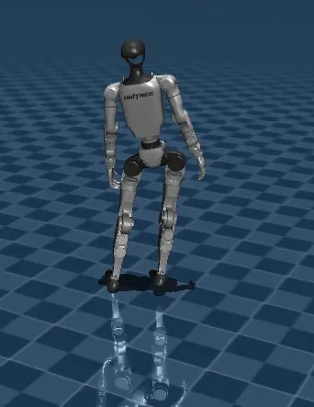
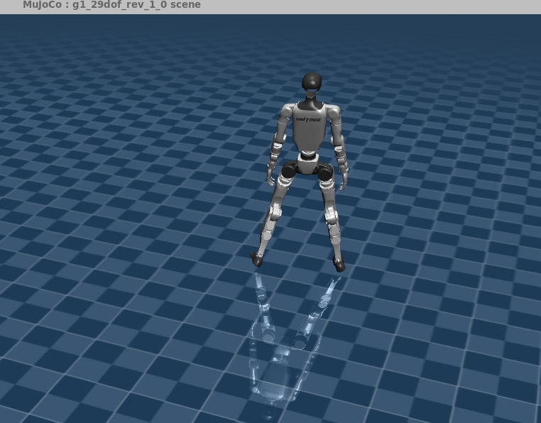
Comparison

Slide 4
conclusion
The gap between the legs seem to be too wide, and the leg lifting is not obvious, might need to continue adjusting

